Slide 1
UNIT 1- PROGRAMMING FUNDAMENTALS
UNIT 1.5: WHAT IS AN ARRAY, HOW TO CREATE AN ARRAY, ARRAY INDEX, ARRAY METHODS

Slide 2
Learning Objective
At the end of this unit, students will be able to
Define data structures
Use arrays as data structures
Identify array indices
Use array methods to
Find array length
Push an element onto array
Pop an element from an array
Sort array
Identify and use nested arrays

Slide 3
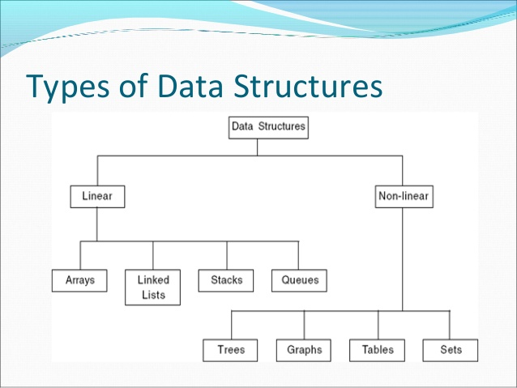
Data Structure
Data structures are used to store and
organize data
Some of the data structures are
Arrays
Lists
Trees

Slide 4
Arrays
Array is a data structure that holds values
Array is a collection of elements
values in an array can be of any data type such as an int or a string
Arrays are very useful for organizing data

Slide 5
Array Declarations
Declare an array
create a variable with any name
initialize the variable with square brackets
var nameOfAnArray = [ ] ;
empty brackets create an array with no value in it

Slide 6
Create an Array
Create an array of your favorite four colors
var colors = [‘purple’ , ‘silver’ , ‘gold’, ‘red’ ] ;
the size of array named colors is 4
Create an array with food names
var food = [‘pizza’ , ‘Hamburger’ , ‘Sweet Fries’, ‘Egg and cheese’];

Slide 7
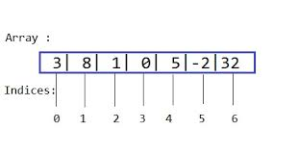
Array Index
Once an array is created, all its values are assigned an index
INDEX ALWAYS STARTS FROM 0
LAST INDEX IS ALWAYS LENGTH OF AN ARRAY - 1

Slide 8
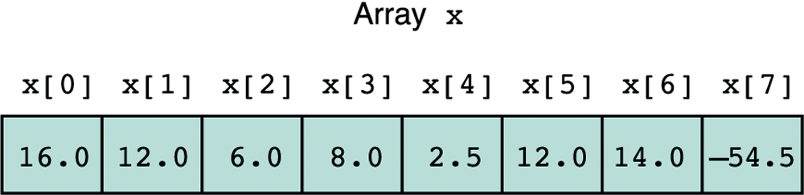
Access Array Values
To access elements in an array
write the name of the array
after the name, in square brackets write the array index
index for first element is always 0
colors [1] ; //look at the colors array and figure out the color

Slide 9
Task –Find the array Index
Using JavaScript and color array,
Print out array element in index 2
Print out the color gold

Slide 10
Task
what is the color stored in colors array index [1]?
what color is stored in index [4]?

Slide 11
Array Methods
Arrays are objects in JavaScript which come with predefined methods to
Length method to find array’s length
Push method to add elements to an array
Pop method to delete array elements
Sort method to sort an array in descending order
RESOURCE for ES6: https://googlechrome.github.io/samples/array-methods-es6/index.html

Slide 12
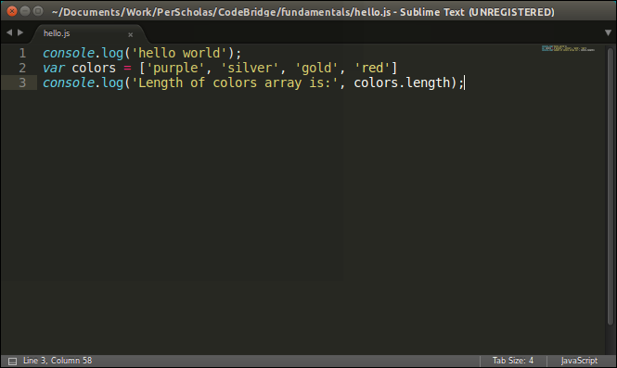
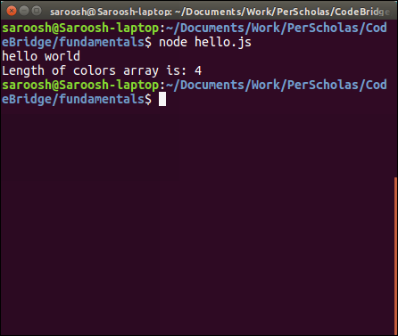
Array method –Length
Javascript has a length method to find the length of any array

Slide 13
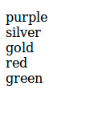
Array method : push()
Array.push( ) method adds an element at the end of an array
add another color to array colors
colors.push(‘green’)
New array becomes:

Slide 14
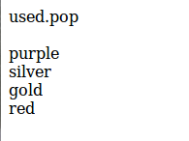
Array methods : pop( )
array.pop( ) method removes the last element of an array
colors.pop( ) removes the last color of the array

Slide 15
Array methods : sort( )
Sort an array by using array.sort( ) method

Slide 16
Populating Arrays
what is an efficient way to create an array for first 50 integers?

Slide 17
For Loop To Populate An Array
Goal: create an Array containing 10 values
idea:
create an empty array
use a for loop to iterate through the array (starting at index 0)
assign a value to every index while iterating the array
Note:
In this case, values assigned are the same as array index. Not always the case

Slide 18
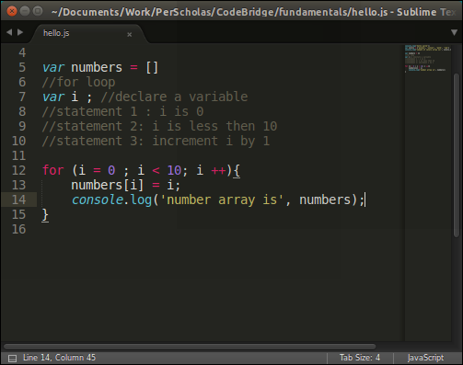
For Loop To Populate An Array

Slide 19
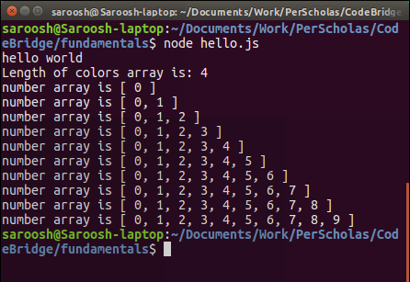
Array being populated using for loop
Number array is printed every time a loop runs.
At the end of every loop, array gets populated with a new number.

Slide 20
JavaScript
Associative Array
Array with a pair of key and value
Are declared as
Var array = {key1 : value1 , key2: value2} // every key has a value
For example
If you want to make a list of students basic info, just an array won’t work. Try using associative arrays

Slide 21
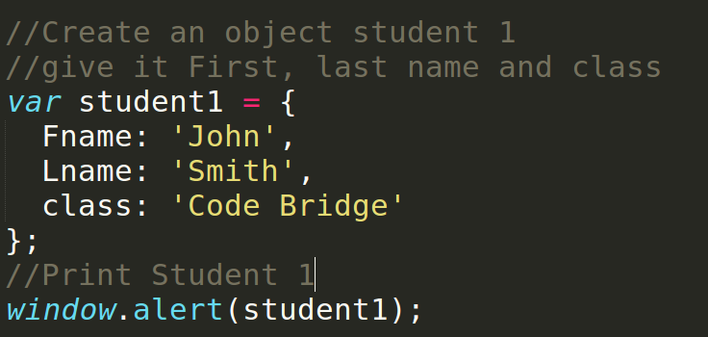
JavaScript
Associative Array: Object and its properties
object
The variable student1 has three keys(Fname, Lname and class) and three values
student1 in this example is an object and its keys are its properties with a value
property
value
use console.log NOT window.alert

Slide 22
Unit Hw
Code Academy - steps 8 & 9
https://csx.codesmith.io/ CSX
Complete challenges:
Functions and Execution Context
Challenge: Array Builder

